Slide 1
Processes and Threads

Slide 2
Multithreading
We defined a process as the Unit of resource ownership as well as the Unit of dispatching of an executable task
We want to separate these two concerns
Resource ownership:
Process remains unit of resource ownership
Program Execution / Dispatching:
A process can have multiple threads of execution
Threads (lightweight processes) become the unit of dispatching
CPU may have multiple cores allowing for true parallel execution of these threads

Slide 3
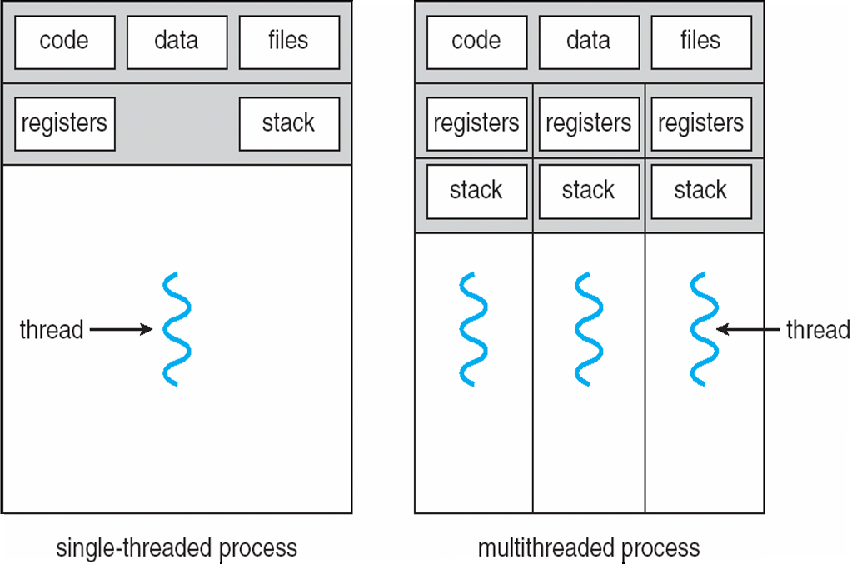
Multithreading
Multithreading is the ability of an operating system to support multiple threads of execution within a single process
Traditional Processes have at least one thread of control
Multiple threads run in the same address space, share the same memory areas
The creation of a thread only creates a new thread control structure, not a separate process image

Slide 4
Process – Unit of Resource Ownership
Unit of resource ownership and protection
Resource ownership:
Process image, virtual address space
Resources (I/O devices, I/O channels, files, main memory)
Protection
Processors, other processes
Operating system protects process to prevent unwanted interference between processes
memory, files, I/O resources

Slide 5
Threads – Units of Dispatch
Thread is defined as the unit of dispatching:
Represents a single thread of execution within a process
Threads are also called lightweight processes
Operating system may be able to manage multiple threads of execution directly (e.g. Linux tasks)
A thread is provided with its own register context and stack space (why?)
Multiple threads run in the same address space, share the same memory areas
The creation of a thread only creates a new thread control structure, not a separate process image

Slide 6
Threads in Unix
Process
Table
Process
Control
Block
Process
Control
Block
Process
Control
Block
Process
Control
Block
Thread
Table
Thread
Control
Block
Actual thread management is dependent on underlying kernel implementation.
Kernel versus user versus mixed user-kernel-level threads

Slide 7
Thread Implementation
Three categories of threads
User-level threads
Kernel-level threads
Mixed user-kernel-level threads
Characterised by the extent that the kernel is involved in their management

Slide 8
User Threads
User Program
Thread Library
User mode
Map threads to processes
Kernel mode
Process Management
Kernel
Operating System unaware of threads, completely controlled by User program

Slide 9
Kernel Threads
User Program
User mode
Kernel mode
Kernel manages threads
Thread Management
Kernel
Operating System manages threads, better mapping of threads to multiple CPU cores

Slide 10
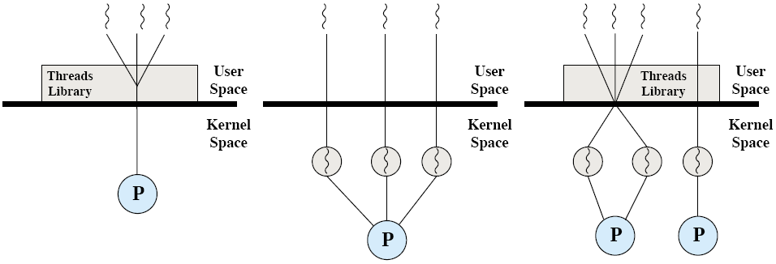
Thread Implementation
Pure User Level Threads
Pure Kernel Level Threads
Combined User / Kernel level threads
Pure User-Level
ULT
Pure Kernel-Level
KLT
Combined Level
ULT/KLT

Slide 11
User-Level Threads
Process
Thread
Thread
Thread
Thread
Thread
Thread Runtime System
Thread Library
Thread Library
Thread Table
Thread Table
User Space
Kernel Space
Process
Control
Block
Process
Table

Slide 12
User-Level Threads
User-Level Threads
Kernel not aware of the existence of threads
Process uses thread library functions to manage its threads
Benefit
Light thread switching in user mode
No mode switch necessary (no call of kernel functions)
We can implement our own thread scheduling
Also called “green threads” on some systems (e.g. Solaris)

Slide 13
User-Level Threads: Disadvantage
Process is still the Unit of Dispatch, not a thread:
Kernel doesn’t know threads
Disadvantage:
Blocking of one thread blocks entire process, including all other threads in it
Only one thread can access the kernel at a time, as the process is the unit of execution known by kernel
No Distribution in Multi-processor systems:
All threads run on the same processor in a multiprocessor system
Threads cannot run in parallel utilising different processors, as the process is dispatched on one processor

Slide 14
Kernel-Level Threads
Process
Process
Thread
Thread
Thread
Thread
Thread
User Space
Kernel Space
Process
Control
Block
Process
Control
Block
Thread
Control
Block
Process
Table
Thread
Table

Slide 15
Kernel-level Threads
Thread is Unit of dispatch
Kernel is aware of the existence of threads
Kernel manages each thread separately
Benefit
Fine-grained scheduling by kernel on thread basis
If one of the threads blocks (e.g. waiting for I/O), another one can be scheduled by kernel without blocking the whole process
Threads can be distributed to multiple processors and run in parallel – true parallelised execution of programs!
Example Systems: Windows XP/7/8, Solaris, Linux, Mac OSX

Slide 16
Kernel-Level Threads: Disadvantage
A context switch between threads of the same process involves kernel
Mode switch: we have to switch CPU into Kernel mode
Mode switch is costly
2 mode switches for each context switch of a thread, is as costly as process switch

Slide 17
Hybrid Implementations User-Kernel-Level Threads
Try to combine advantages of both user-level and kernel-level threads
User-level: light-weight thread switching
Kernel-level: allows dispatch at thread level (same or different process), when one thread blocks
true parallelism of threads in multiprocessor systems possible
Basic technique: Mapping of user-level threads onto a limited set of kernel threads
Different hybrid Multithreading Models:
Many-to-one
One-to-one
Many-to-many

Slide 18
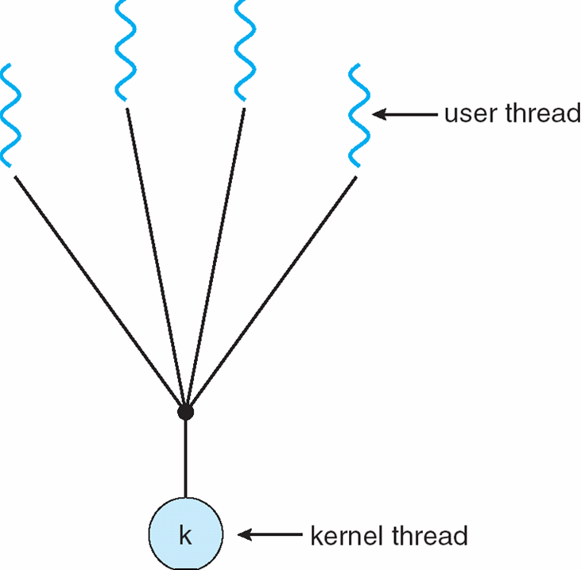
Many-to-One Model
All user-level threads of one process mapped to a single kernel-level thread / process
These are the User-level threads as discussed before
Thread management in user space
Efficient
Application can run its own scheduler implementation
One thread can access the kernel at a time
Limited concurrency, limited parallelism
Examples
“Green threads” (e.g. Solaris)
Gnu Portable Threads

Slide 19
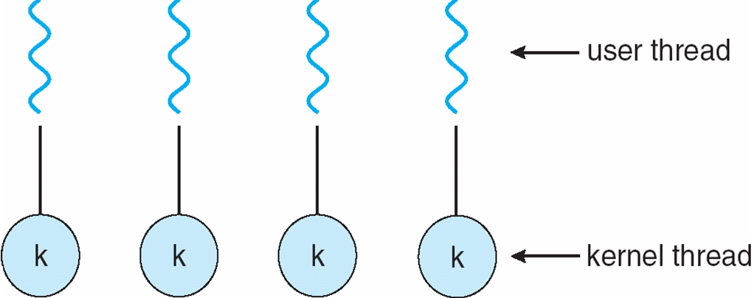
One-to-One Model
Each user-level thread mapped to a kernel thread
These are the Kernel-level threads as discussed before
One blocking thread does not block other threads
Multiple threads access kernel concurrently
Problem
Kernel may restrict the number of threads created
Example systems
Windows, Linux, Solaris 9 (and later), Mac OSX

Slide 20
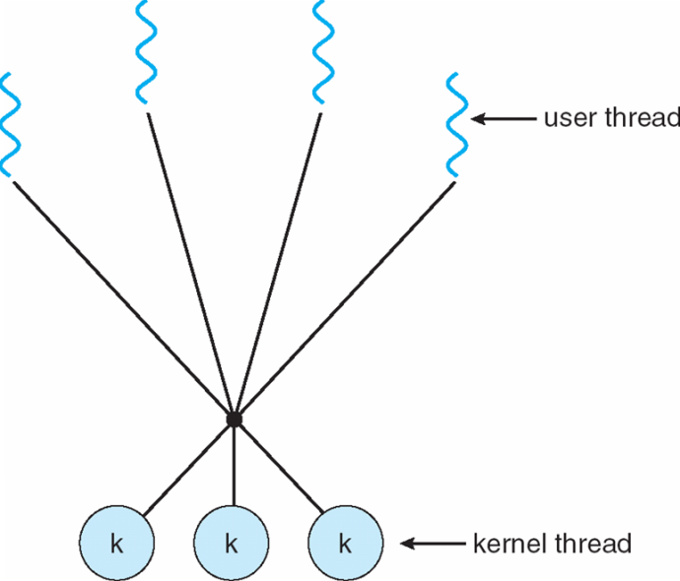
Many-to-Many Model
Many user-level threads are multiplexed (mapped dynamically) to a smaller or equal number of kernel threads
Thread pool, no fixed binding between a user and a kernel thread
The number of kernel threads is specific to a particular application or computer system
Application may be allocated more kernel threads on a multiprocessor architecture as on a single-processor architecture
No restriction on user-level threads
Applications can be designed with as many user-level threads as needed
Threads are then mapped dynamically onto a smaller set of currently available kernel threads for execution
Virtualisation concept for threads

Slide 21
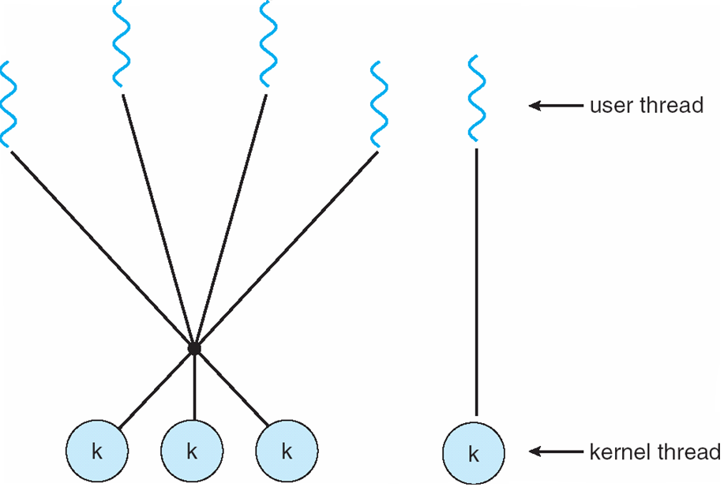
Two-level Model
Is a variant of the Many-to-Many model, allows a fixed relationship between a user thread and a kernel thread
Was used in older Unix-like systems
IRIX, HP-UX, True64 Unix, Solaris 8

Slide 22
Threading Issues – Thread Pools
Threads come with some overhead
Unlimited thread creation may exhaust memory and CPU
Solution
Thread pool: create a number of threads at system startup and put them in a pool, from where they will be allocated
When an application needs to spawn a thread, an allocated thread is taken from the pool and adapted to the application’s needs
Advantage
Usually faster to service a request with already instantiated thread then creating a new one
Allows number of threads in applications to be bound by thread pool size
Number of pre-allocated threads in pool may depend on
Number of CPUs, memory size
Expected number of concurrent requests

Slide 23
Threading Issues – fork() and exec()
Semantics of fork() and exec() changes in a multithreaded program
Remember:
fork() creates an identical copy of the calling process
In case of a multithreaded program
Should the new process duplicate all threads?
Or should the new process be created with only one thread?
If after fork(), the new process calls exec() to start a new program within the created process image, only one thread may be sufficient
Solution: some Unix systems implement two versions of fork()

Slide 24
Threads
All threads share the same address space
Share global variables
All threads share the same open files, child processes, signals, etc.
There is no protection between threads
As they share the same address space they may overwrite each other’s data
As a process is owned by one user, all threads are owned by one user

Slide 25
Motivation for Threads
(1) Request
(2) Create new thread to service the request
Client
Server
Thread
(3) Resume listening for additional client requests

Slide 26
Threads vs Processes: Advantages
Advantages of Threads
Much faster to create a thread than a process
Spawning a new thread only involves allocating a new stack and a new thread control block
10x faster than process creation in Unix
Less time to terminate a thread
Much faster to switch between threads than to switch between processes
Threads share data easily
Thread communication very efficient, no need to call kernel routines, as all threads live in same process context

Slide 27
Threads vs Processes: Disadvantages
Disadvantages
Processes are more flexible
They don’t have to run on the same processor
No protection between threads
Share same memory, may interfere with each other
If threads are implemented as user threads instead of kernel threads
If one thread blocks, all threads in process block

Slide 28
Thread Programming
POSIX standard threads: pthreads
Describes an API for creating and managing threads
There is at least one thread that is created by executing main()
Other threads are spawned / created from this initial thread

Slide 29
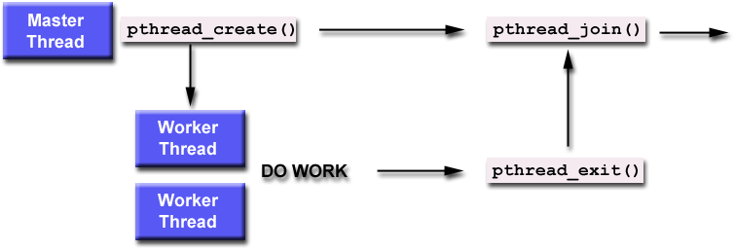
Thread Programming Wait for completion with join()
Functions:
pthread_create()
pthread_exit()
pthread_join()

Slide 30
POSIX Thread Programming
Thread creation
Returns a new thread ID with parameter “thread”
Executes the routine specified by “start_routine” with argument specified by “arg”
Thread termination
Terminates the thread, sends “status” to any thread waiting by calling pthread_join()
pthread_create ( thread, attr, start_routine, arg )
pthread_exit ( status )

Slide 31
POSIX Thread Programming
Thread synchronisation
Blocks the calling thread until the thread specified by “threadid” terminates
The argument “status” passes on the return status of pthread_exit(), called by the thread specified by “threadid”
Thread yield
Calling thread gives up the CPU and enters the Ready queue
pthread_join ( threadid, status)
pthread_yield ( )

Slide 32
Linux Threads
No distinction between processes and threads
User-level threads are mapped into kernel-level processes (called “tasks”)
A clone() system call exists
A new process is created by copying the attributes of the current process
Cloned processes share resources, but have separate stacks
For each process, a task_struct is created, similar to a process control block

Slide 33
Mac OSX Grand Central Dispatch
Thread pool
Mac OSX can operate on even more fine-grained elements:
Blocks of program code are Units of dispatch
A software designer can designate portions of program code, called blocks, that may be dispatched independently and run concurrently
These are extensions to a programming language
Concurrency depends on the number of CPU cores available and the thread capacity of a system

Slide 34
SMP Support – Processor Affinity
Processor Affinity: Relationship between a thread and a processor
No affinity
Threads of any process may run on any processor
No guarantee that they are rescheduled on the same processor after interruption
Soft affinity:
Dispatcher tries to re-assign threads to the same processor after interruption
Helps to reuse data still held in processor cache, less cleanup and reload necessary
Hard affinity
Application restricts execution of a thread to a particular processor / processor core

Slide 35
Summary
User-level threads
Created and managed by a thread library that runs in the user space of a process
No mode switch required to switch from one thread to another
Only a single user-level thread within a process can execute at a time, no execution in parallel on a multiprocessor system
If one thread blocks, the entire process is blocked
Kernel-level threads
Threads within a process are maintained by the kernel
A mode switch is required to switch from one thread to another
Multiple threads within the same process can execute in parallel on a multiprocessor system
Blocking of one thread does not block the entire process
Process: resource ownership
Thread: program execution / dispatching

